Slide 1

EMPLOYEES’ REVIEWS: WHAT YOU DON’T KNOW!
HA TRAN
GALVANIZE DATA SCIENCE IMMERSIVE - DS56

Slide 2
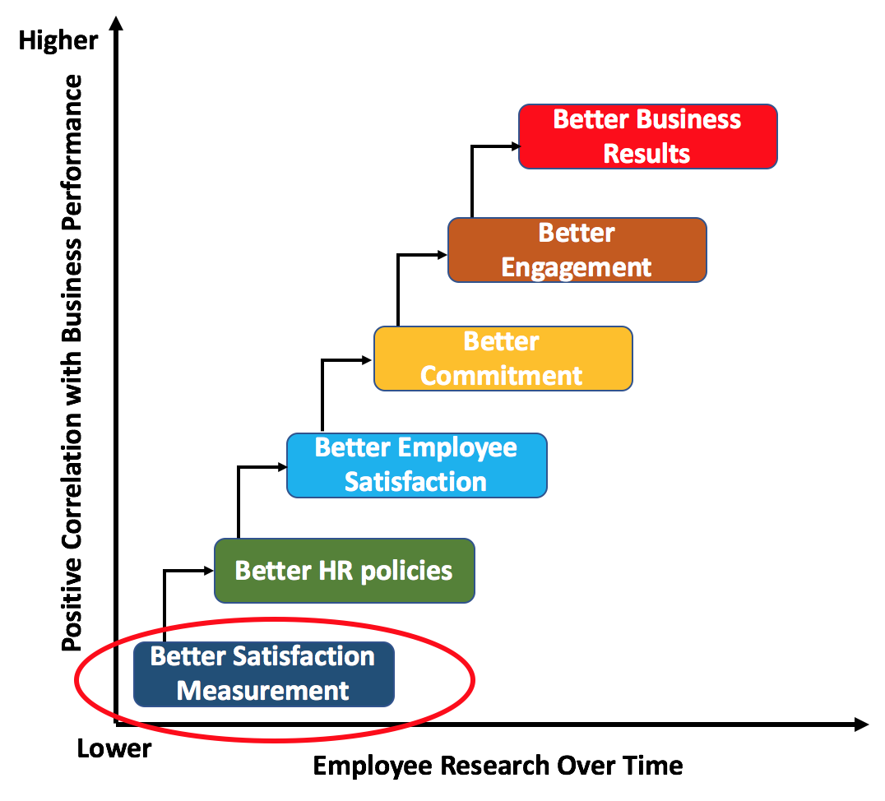
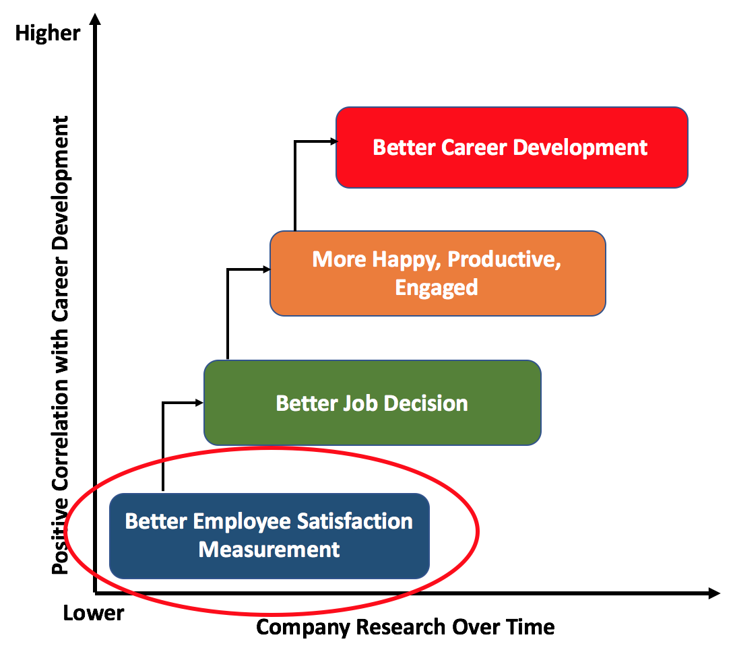
Why is better satisfaction measurement important?
Employers
Job Seekers
Notes:
Provide additional insight to employer about their employees’ satisfaction.
Discrepancy between rating vs. text companies.

Slide 3
Why is external employee rating data important?
Employee Satisfaction Management
Internal Employee Satisfaction Rating Survey
External Employee Satisfaction Rating Site
Better survey design
Better former employee data
Higher current employee participation
Cross-companies comparison ability
Lower confidentiality
X
Anonymous data
No cross-companies comparison
Public data - everyone can access
X
No public data
X
X
Convenient employee samples
Notes:
Provide additional insight to employer about their employees’ satisfaction.
Discrepancy between rating vs. text companies.

Slide 4
Why is external employee rating data important?
The external employee sites as Glassdoor.com and Indeed.com have become the important source for job seekers’ decision making.
> 70% job seekers looked at company review sites.
69% of them declined the offers from bad companies even they are unemployed
(Allegis Group Services Study, August 2012)

Slide 5
Why is external employee rating data important?
The external employee sites as Glassdoor.com and Indeed.com have become the important source for job seekers’ decision making.
> 70% job seekers looked at company review sites.
69% of them declined the offers from bad companies even they are unemployed
(Allegis Group Services Study, August 2012)

Slide 6
What are the problems of external rating data?

Slide 7
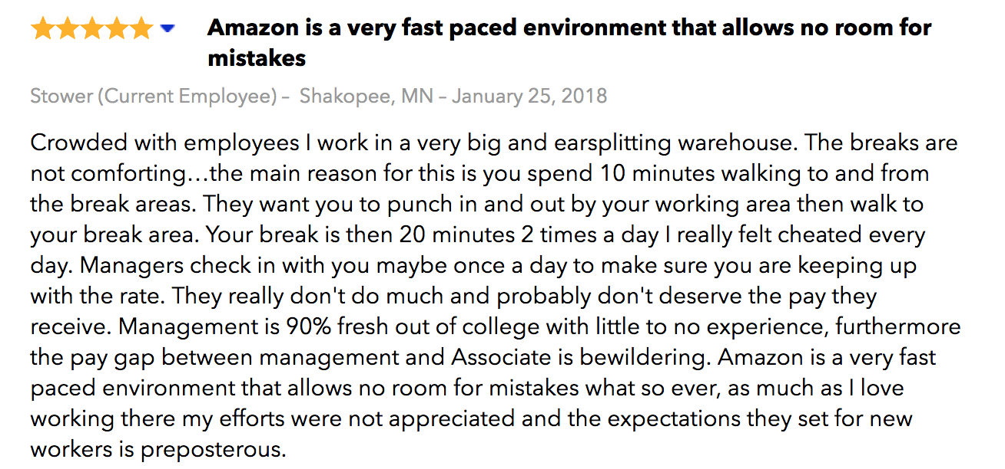
What are the problems of external rating data?
Discrepancy between the star score and text information
Notes:
Provide additional insight to employer about their employees’ satisfaction.
Discrepancy between rating vs. text companies.

Slide 8
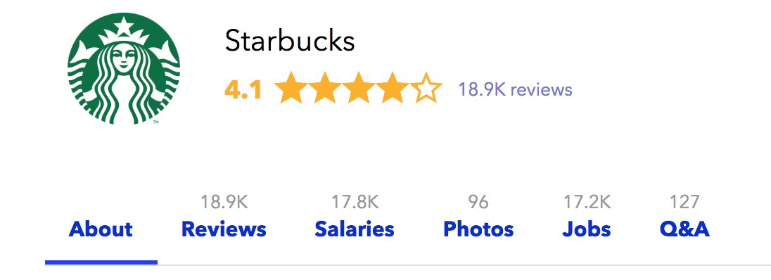
What are the problems of external rating data?
Discrepancy between the star score and text information
Many reviews with possible very long text
Notes:
Provide additional insight to employer about their employees’ satisfaction.
Discrepancy between rating vs. text companies.

Slide 9
What are the problems of external rating data?
Discrepancy between the star score and text information
Many reviews with possible very long text
Notes:
Provide additional insight to employer about their employees’ satisfaction.
Discrepancy between rating vs. text companies.

Slide 10
This project will solve these problems!
Notes:
Provide additional insight to employer about their employees’ satisfaction.
Discrepancy between rating vs. text companies.

Slide 11
OBJECTIVES
Objective 1: test hypothesis
Determine if the text comments provide more insight employees’ satisfaction information
Objective 2: develop back-end product
Construct a new rating scale by combining “text” scores and standard 1 - 5 numeric scores
KMeans
PCA
Logistic Regression
Decision Tree
Ada Boosting
Naive Bayes
Random Forest
Gradient Boosting
Objective 3: develop front-end product
Develop a recommender system for the specific job seeker
Sentiment Analysis (Natural Language Processing) for text review scoring.
“Revised” Matrix Factorization
Web-app
Notes:
Speaker louder. Speak louder

Slide 12
DATA SOURCE
~ 60,000 reviews of 33 companies from indeed.com:
Offices in Seattle.
Data scientist/analyst positions.
At least 300 reviews.
2011 – 2018
Data: former/current employee, date, location, position, text comment, rating.
Methodology: Selenium for web-scraping, AWS RDS for data management.

Slide 13
OBJECTIVES
Objective 1: test hypothesis
Determine if the text comments provide more insight employees’ satisfaction information
Objective 2: develop back-end product
Construct a new rating scale by combining “text” scores and standard 1 - 5 numeric scores
KMeans
PCA
Logistic Regression
Decision Tree
Ada Boosting
Naive Bayes
Random Forest
Gradient Boosting
Objective 3: develop front-end product
Develop a recommender system for the specific job seeker
Sentiment Analysis (Natural Language Processing) for text review scoring.
“Revised” Matrix Factorization
Web-app
Notes:
Speaker louder. Speak louder

Slide 14

Objective 1: text comments provide further satisfaction information
Surrogate predictor: employees staying/leaving the companies.
Compare the performances of nested models: with text vs. without text information.
Logistic Regression
Decision Tree
Ada Boosting
Naive Bayes
Random Forest
Gradient Boosting
Location, Date, Position, Review Scores, ...
Y
Location, Date, Position, Review Scores, ...
Text
Y
KMeans/ PCA

Slide 15
Objective 1: text comments provide further satisfaction information

Slide 16
OBJECTIVES
Objective 1: test hypothesis
Determine if the text comments provide more insight employees’ satisfaction information
Objective 2: develop back-end product
Construct a new rating scale by combining “text” scores and standard 1 - 5 numeric scores
KMeans
PCA
Logistic Regression
Decision Tree
Ada Boosting
Naive Bayes
Random Forest
Gradient Boosting
Objective 3: develop front-end product
Develop a recommender system for the specific job seeker
Sentiment Analysis (Natural Language Processing) for text review scoring.
“Revised” Matrix Factorization
Web-app
Notes:
Speaker louder. Speak louder

Slide 17
Objective 2: Construct a new rating scale = f(“text” ,1* - 5* scores)
Text → NLP (Sentiment Analysis) → Score
Rating (1* - 5*) -------------------------> Score
Final Score

Slide 18
Objective 2: Construct a new rating scale = f(“text” ,1* - 5* scores)
Work life balance score
Benefit and compensation score
Job security and advancement score
Management score
Culture score
Final Score: range from -1 → 1

Slide 19
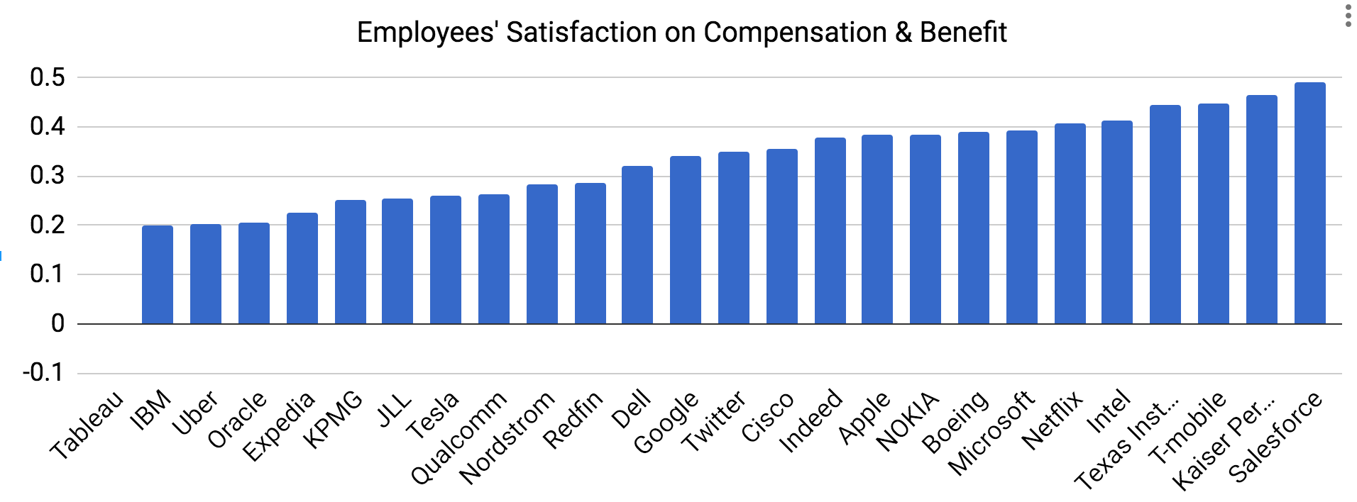
Objective 2: Construct a new rating scale = f(“text” ,1* - 5* scores)

Slide 20
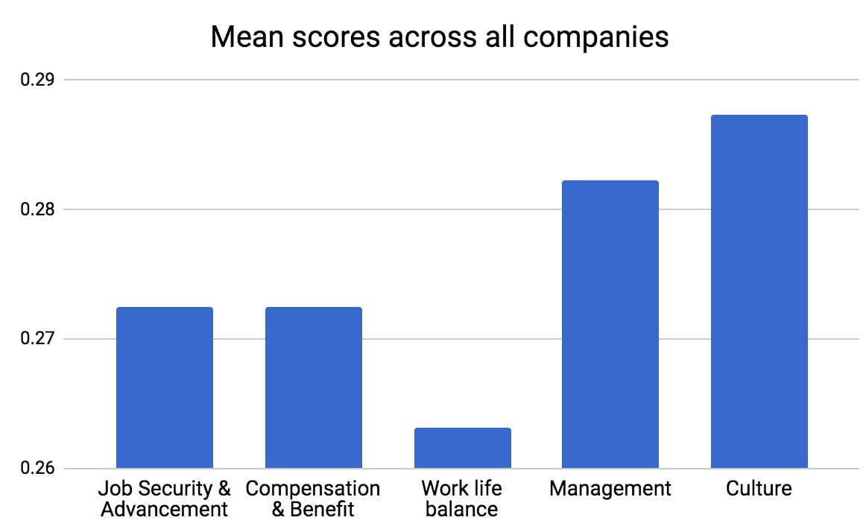
Objective 2: Construct a new rating scale = f(“text” ,1* - 5* scores)
Score: [-1,1]

Slide 21
Future Direction
Objective 3: Recommender system for the specific job seeker.
Objective 4: Forecasting employees’ ratings for each companies.

